Slide 2
Obstetrics

Slide 3
Obstetrics Section
Includes only procedures performed on the products of conception
Operations on the pregnant female are coded in the Medical and Surgical section (e.g., episiotomy)
Two root operations unique to this section
Other root operations same as Medical and Surgical section (e.g., Drainage, Inspection)
Contains a single body system: Pregnancy
Root Operation
Abortion: Artificially terminating a pregnancy
Delivery: Assisting the passage of the products of conception from the genital canal

Slide 4
Obstetrics Section
Body Part
Contains three different values for body part
Products of Conception
Products of Conception, Retained
Products of Conception, Ectopic
Products of conception refers to all components of a pregnancy, including the fetus, embryo, amnion, umbilical cord and placenta
There is no differentiation of the products of conception based on gestational age
Some device values unique to this section
Examples:
Laminaria
Abortifacient
Monitoring Electrode

Slide 5
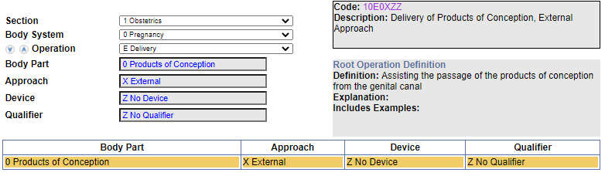
Clinical Examples
Code the case Abortion, Spontaneous Manually assisted
Code Navigation:

Slide 6
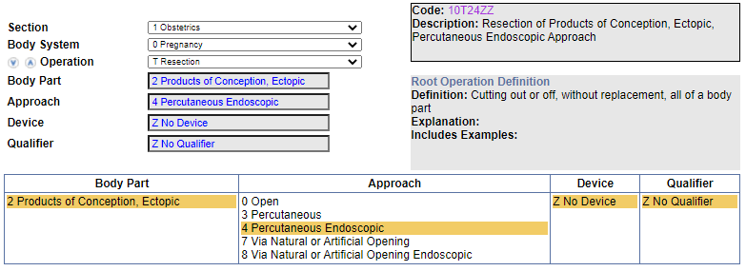
Clinical Examples
Tubal Pregnancy, Laparoscopic total removal
Code Navigation:

Slide 7
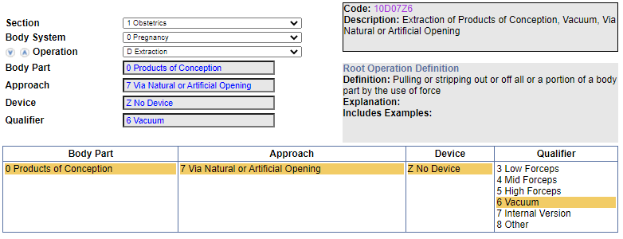
Knowledge Check
Delivery, Breech with Vacuum
Code Navigation:

Slide 8
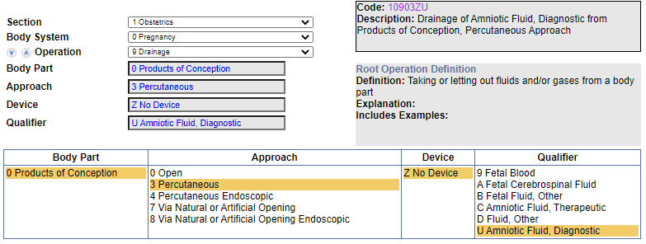
Knowledge Check
Amniocentesis for Genetic Testing
Code Navigation:

Slide 9
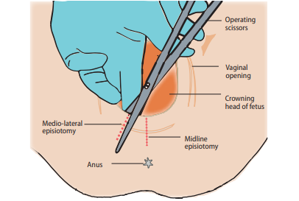
Operative Report 1
Procedure: Delivery, vaginal with Episiotomy and Repair
Description: The patient was complete on cervical examination and was encouraged to push. When the fetal head was crowning, a right mediolateral episiotomy was made and after that a live female infant delivered in the occiput anterior position with tight nuchal cord x1 with Apgar of 8, 9, and 9. Weight was 3,350 grams and anterior shoulder and posterior shoulder delivered without any difficulties with the rest of the body. The cord was clamped and cut. The baby was handed to the awaiting pediatrician. The placenta was delivered spontaneously intact with three-vessel cord. Inspection of the perineum showed a second degree left vaginal wall laceration, which was repaired with 2-0 Vicryl and a right mediolateral episiotomy which was repaired with 2-0 and 3-0 Vicryl. The patient tolerated the procedure very well.
10E0XZZ – Delivery of Products of Conception, External Approach
0W8NXZZ – Division of Female Perineum, External Approach
0KQM0ZZ – Repair Perineum Muscle, Open Approach

Slide 10
Operative Report 2
Procedure: Cesarean Section, Emergency
Description: A 28-year-old female presented for medical induction of labor due to pre-eclampsia. Three trials of Cervidil failed to produce contractions of adequate strength and duration. On the third day of admission, Pitocin induction was attempted. Due to maternal exhaustion at the trials of labor, the decision was made to rupture membranes. Mid forceps and vacuum assistance were tried to no avail. Despite favorable prenatal cephalopelvic measurements, the patient was determined to be in obstructed labor due to disproportion. After three hours of pushing efforts with assistance and resultant maternal exhaustion, the decision was made to deliver by emergency cesarean section. The patient delivered a term liveborn female infant by low transverse cesarean section (LTCS)
10D00Z1 – Extraction of Products of Conception, Open Approach
10907ZC – Drainage of Amniotic Fluid, Therapeutic from Products of Conception, Via Natural or Artificial Opening
3E0P7VZ – Introduction of Hormone into Female Reproductive, Via Natural or Artificial Opening
3E033VJ – Introduction of other Hormone into Peripheral Vein, Percutaneous Approach

